Slide 1
Thyroid Spot App
Name: Chua Chee Hean
Matrix: 1806562C
Supervisor: Ms Fua Ying Huey

Slide 2
Background
Initiated by A*STAR, the Thyroid Spot App is a web application for patients having thyroid diseases and clinicians.
This app allows patients and clinicians to track patients’ condition through their own thyroid hormone readings.
Furthermore, clinicians can manage patients such as determining the patient’s optimal medicine dosage through charts.
This app also provides a dedicated thyroid disease page containing info from symptoms to treatment
As well as a forum should patients have queries about a particular disease which a clinician can answer.

Slide 3
Targeted Users
Patients with diagnosed thyroid illnesses
Elderly patients
Doctors who specialize in thyroid illnesses

Slide 4
Features
View patient test results, also able to add and edit.
Adding test results: unit conversion of FT4 and TSH
Chart calculation based on the total test results
Enlarged calculated chart in a modal
Export all test results as CSV format
View patient’s prescription, along with latest test results and diagnosis (can be exported to PDF file)
Upload prescription image for clinician’s evaluation
Search patient’s test results based on date
Disease page and disease page details
Keyword search feature for disease page
Forum + comment section for each disease/illness.

Slide 5
Existing Products
Features | Thyroid Spot App | Prototype app (2017)
Web version available? | Yes, features mobile design compatible with both iOS and android devices | No, but two separate apps for patients and clinicians respectively
Chart readings? | Yes | Yes
Keeping patient records | Yes | Yes
Able to view patient’s prescription | Yes, patients and clinicians can view and edit image as well | Yes
Clinicians able to view their patients’ records? | Yes | Yes
Dedicated forum for thyroid illnesses? | Yes | No
Searching patient readings | Yes | No
Page containing info about different thyroid illnesses? | Yes | No
Exportation | Able to export prescription with latest readings into PDF, and exporting all FT4 and TSH readings to CSV | Able to export FT4 and TSH readings into text files (“.txt”)

Slide 6
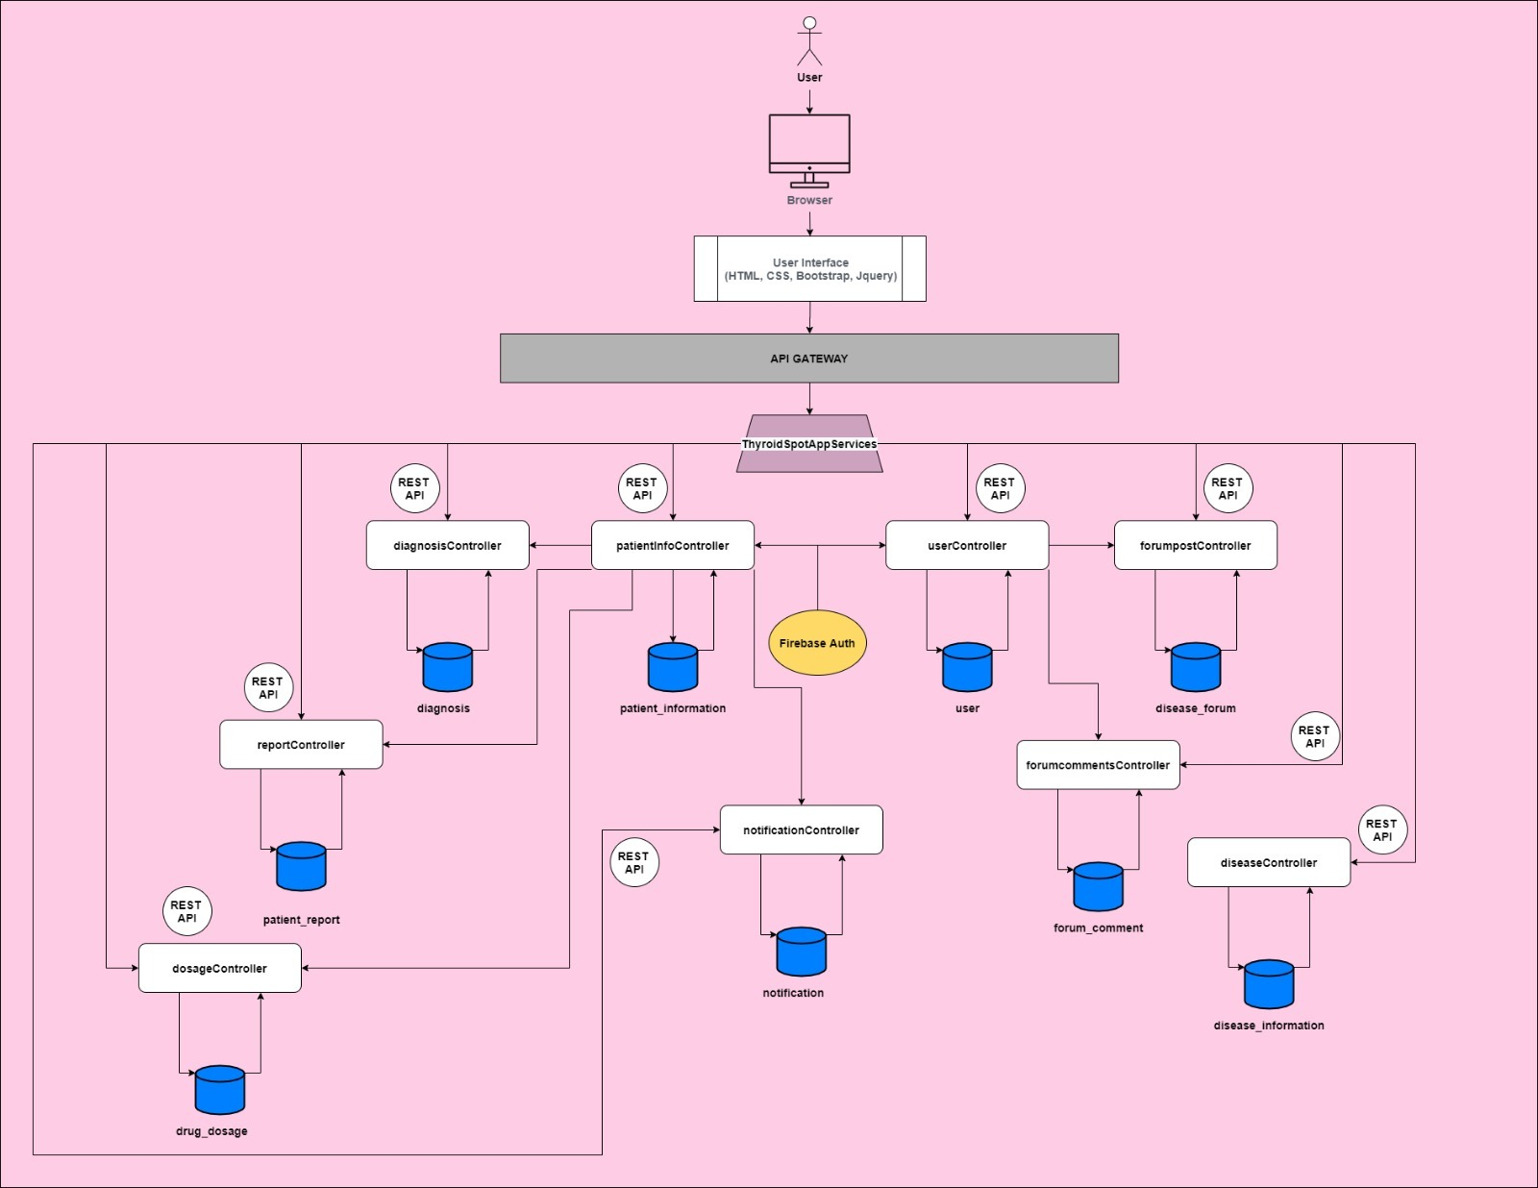
System Architecture

Slide 7
Assumptions
Patients can have more than 1 reading per day
Patients can have more than 1 medication
Patients can be diagnosed with more than 1 thyroid illness

Slide 8
User Guide
After signing up by creating user details and patient information, the patient user will be directed to the profile page
The patient can then choose to view FT4 and TSH results by clicking on the ‘Health’ tab in the navbar
From there, the patient can see his/her test readings, as well as the calculated chart
Which he/she can add latest test readings, or edit if he/she has entered incorrectly
The patient can view diagnosis, prescription, and expand the chart
He/she can also view all thyroid diseases in the ‘Disease’ tab of the navbar
As well as forums and comments, which he/she can contribute to the discussion

Slide 9
Limitations
The current limitations of this app is that the chart is restricted in terms of data display

Slide 10
Future Enhancement
Subscription-based system for patient users, where patients can get full features after paying a monthly fee
Enhance the chart capabilities to display more types of data
Adding on a chatbot for further inquires on illnesses, setting appointment with clinicians, and FAQs

Slide 11
Challenges / Lessons Learnt
Challenges faced:
We started 3 weeks later than other MP projects, which gives us limited time to do the project
Initially, I was confused about the objectives of this project
No full detailed list of functions was given by the client side, but a prototype was given instead to refer
Lessons Learnt:
Establishing a common understanding in the group
Updating each other on work progress regularly
Providing each other feedback whenever possible

Slide 12
Thank You

